Slide 1

elevating fundraising events
Paddle Raise Success
@SwaimStrategies

Slide 2
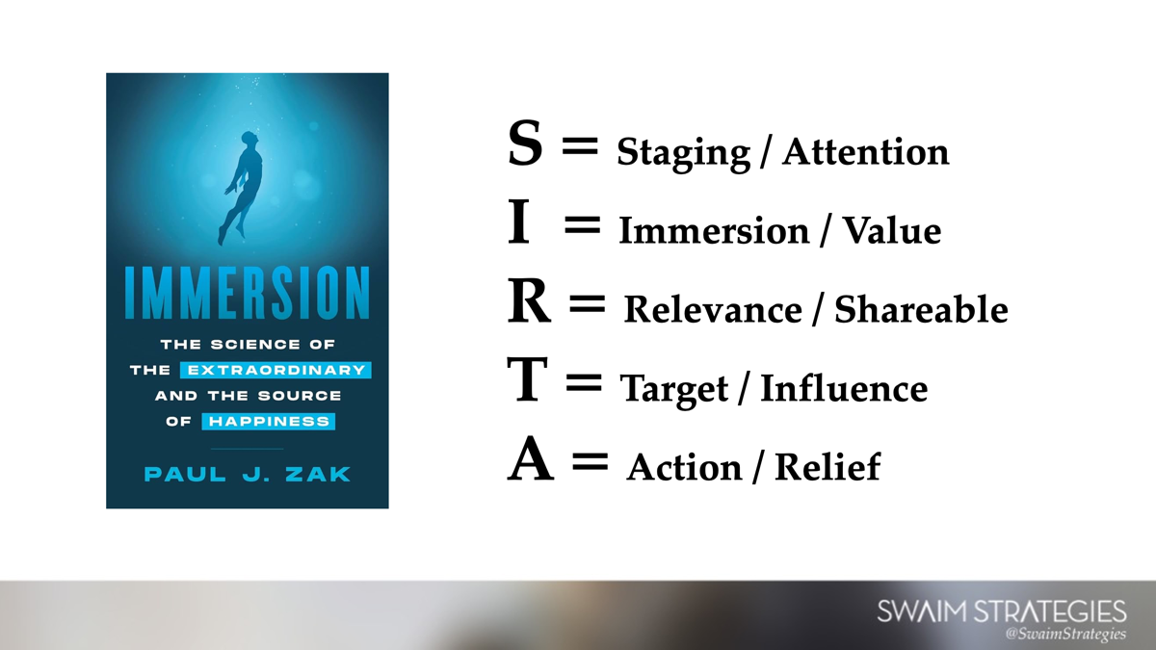

Slide 3
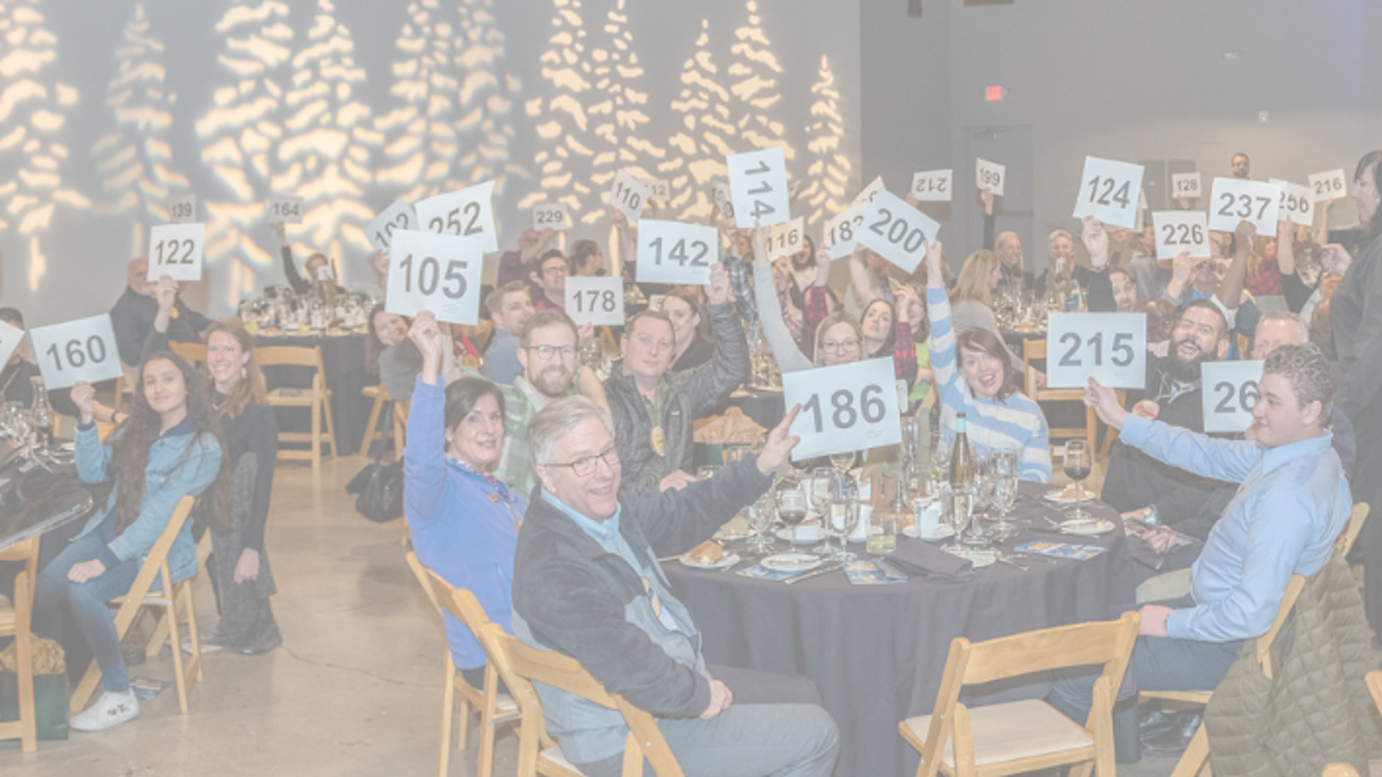


Slide 4

What is a Paddle Raise?
Notes:
Human Economics – limited time and limited attention
Fundraising is your priority make it one
Build your case and your momentum
Our moment of collective action

Slide 5
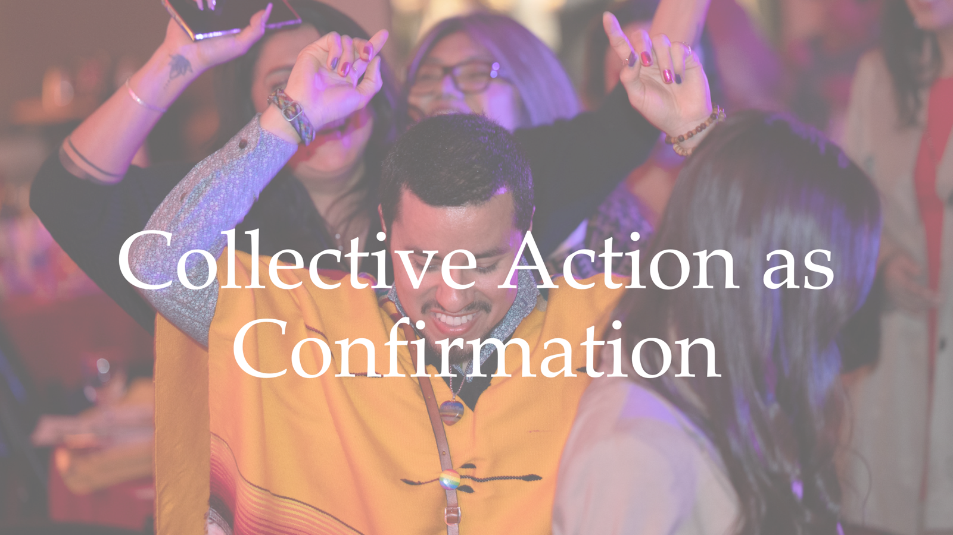

Slide 6
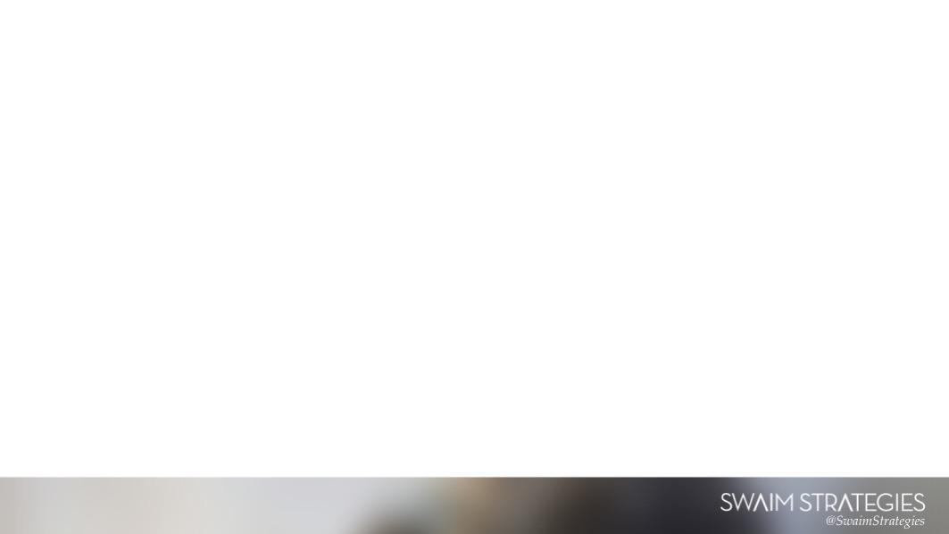
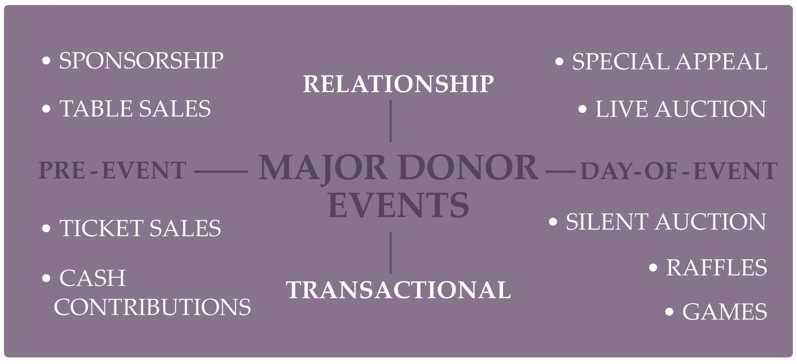

Slide 7
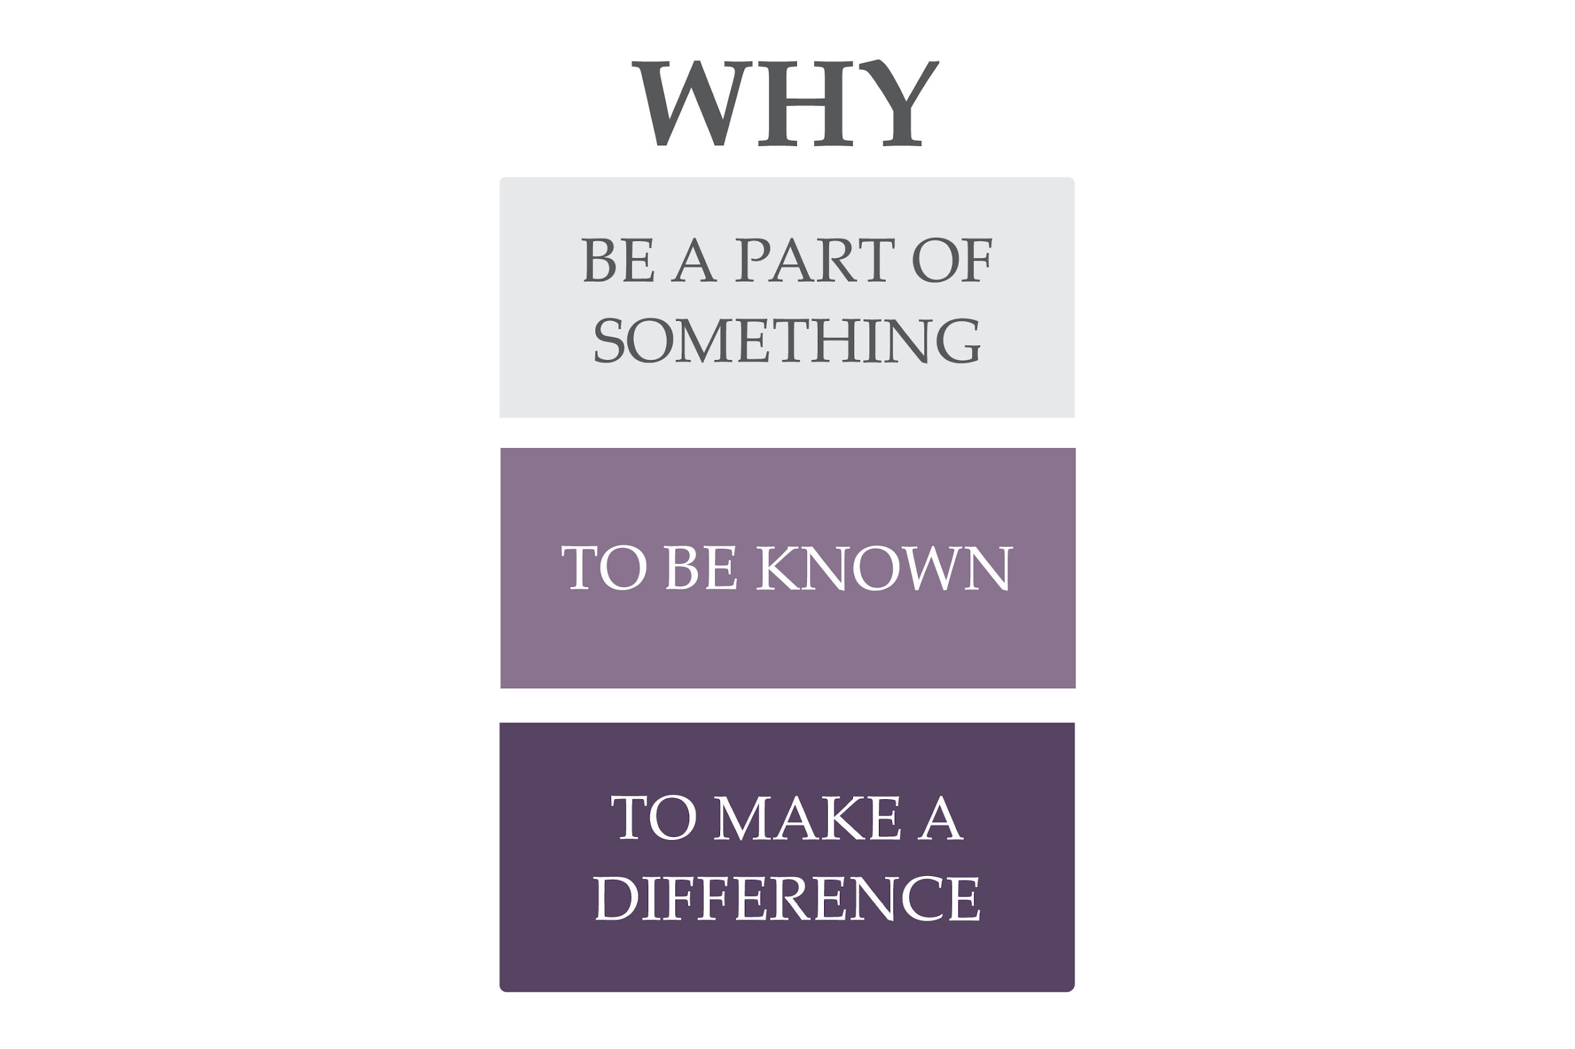
*Susan Howlett, Strengthening Nonprofits

Slide 8
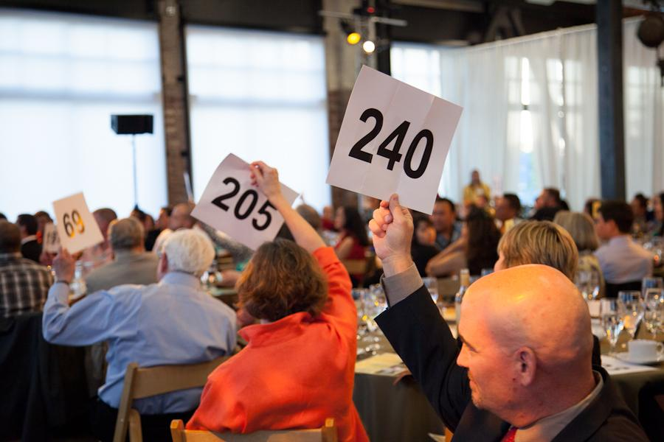
Paddle Raise
Unrestricted funding
Donor cultivation strategy
Opportunity to be a part of something – collective action
Opportunity to be recognized

Slide 9
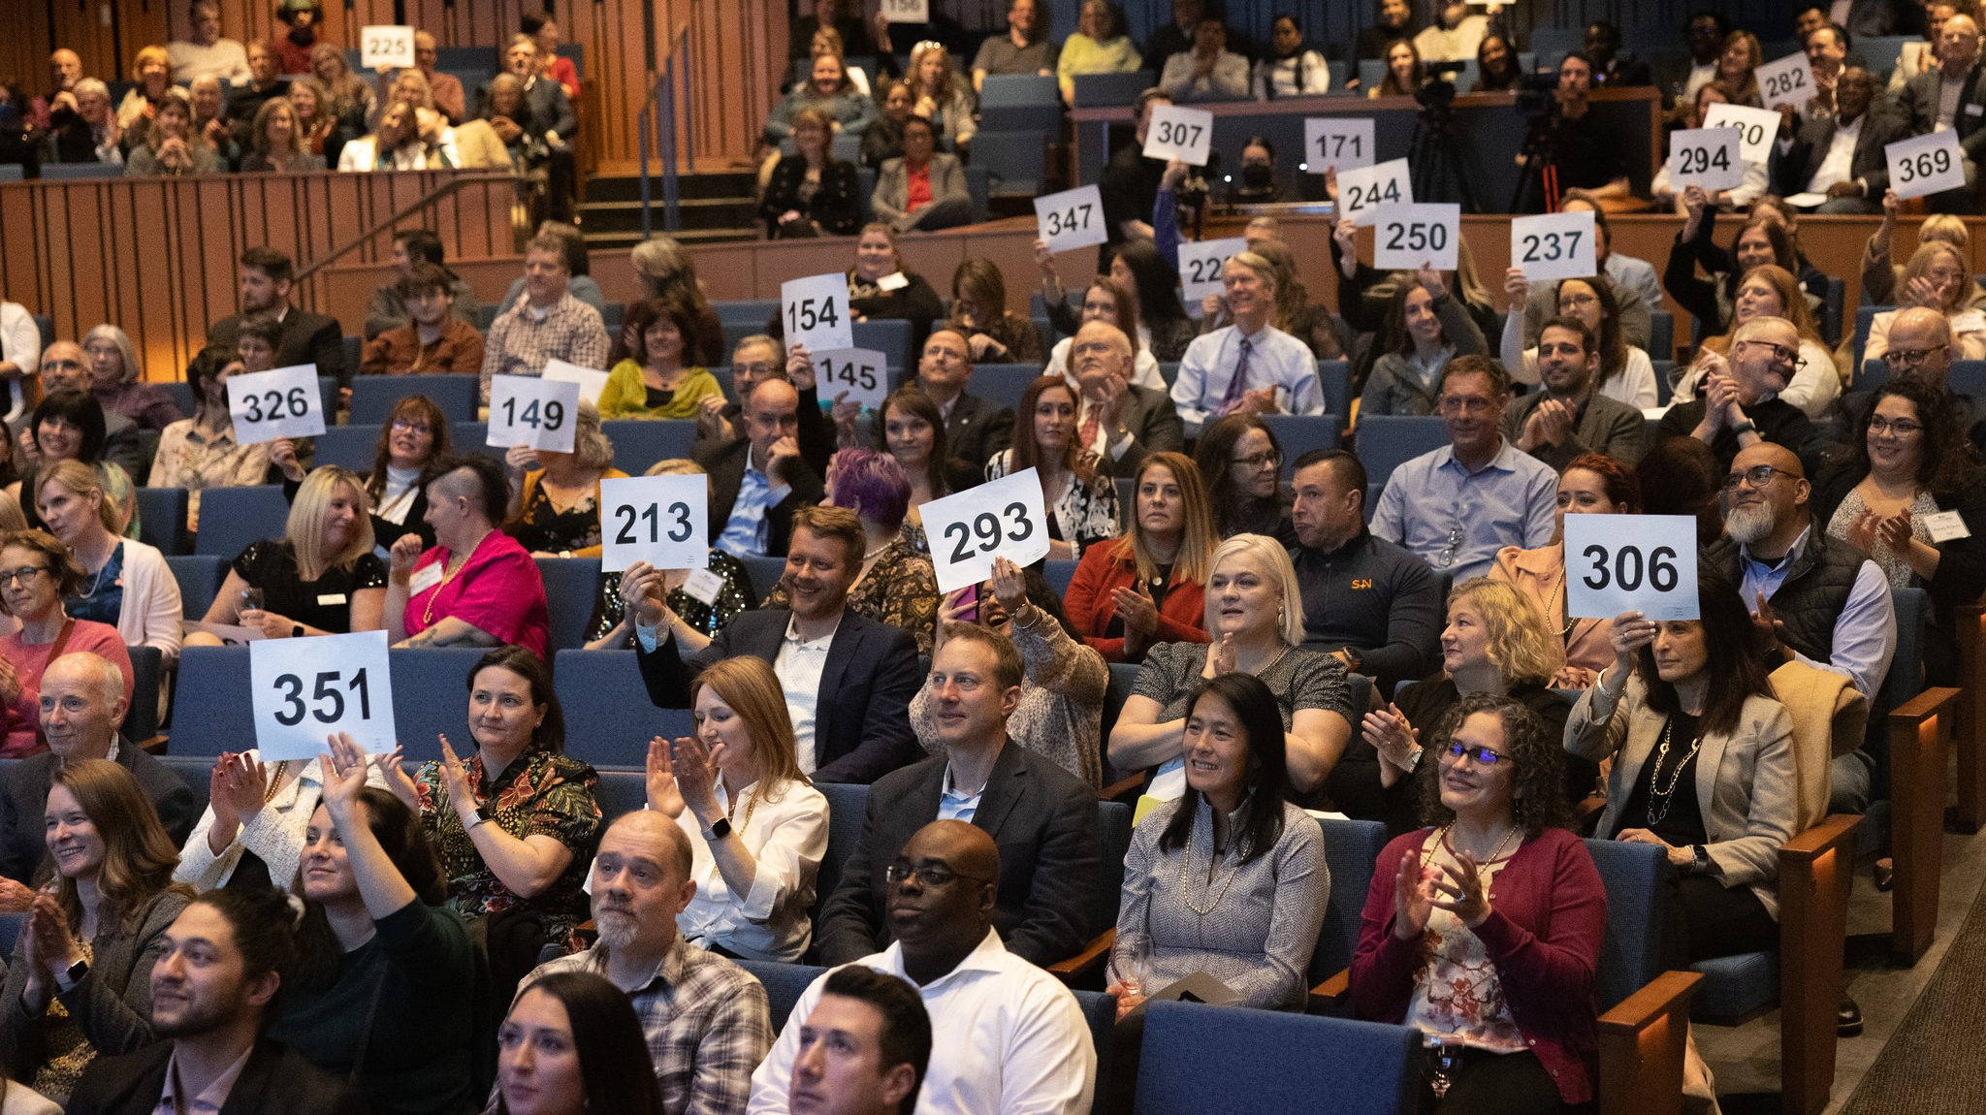
The Event Arc – When Do You Ask?
Notes:
Human Economics – limited time and limited attention
Fundraising is your priority make it one
Build your case and your momentum

Slide 10
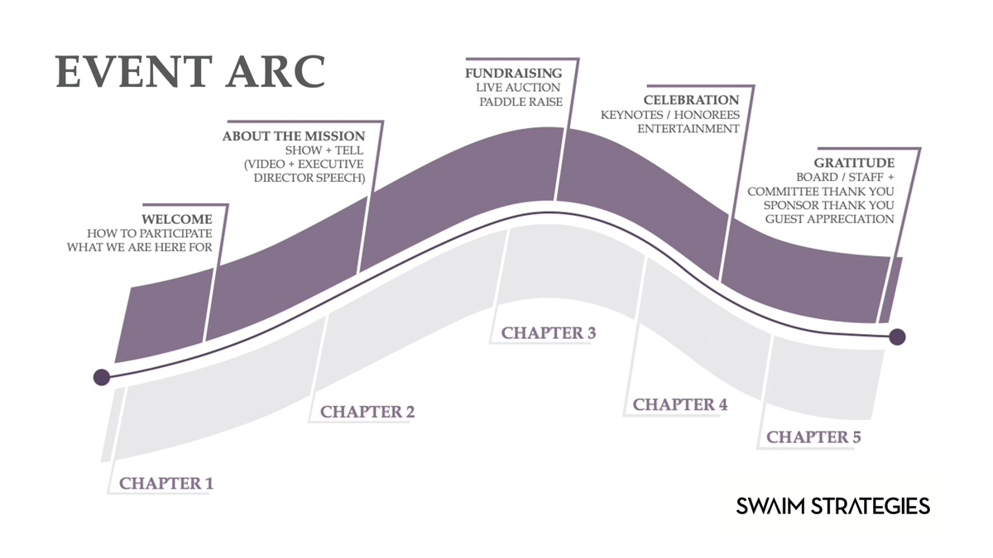
Notes:
Don’t have the energy but also the distraction of a 300-person ballroom
If done well it’s a very intimate conversation with your donor

Slide 11

Elements of a Paddle Raise
Notes:
Design for your purpose

Slide 12
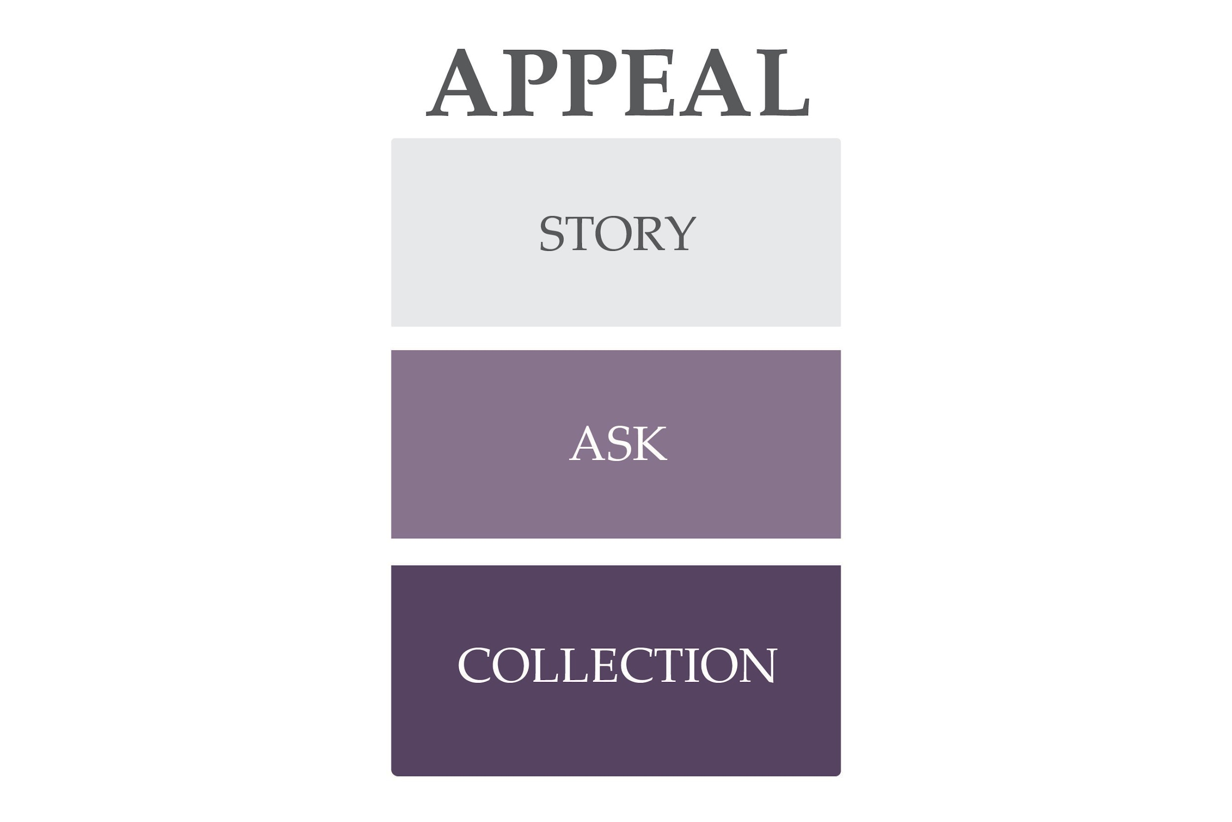
Notes:
Don’t have the energy but also the distraction of a 300-person ballroom
If done well it’s a very intimate conversation with your donor

Slide 13

Impact Story
Notes:
Design for your purpose

Slide 14

*Slovic, P. (2007). ”If I look at the mass I will
never act”: Psychic numbing and genocide.
Judgment and Decision Making, 2, 79-95.
Available at www.decisionresearch.org

Slide 16
50% Drop

Slide 17
One Person’s Story
Before
Change Agent / YOU
After
Notes:
Design for your purpose

Slide 18
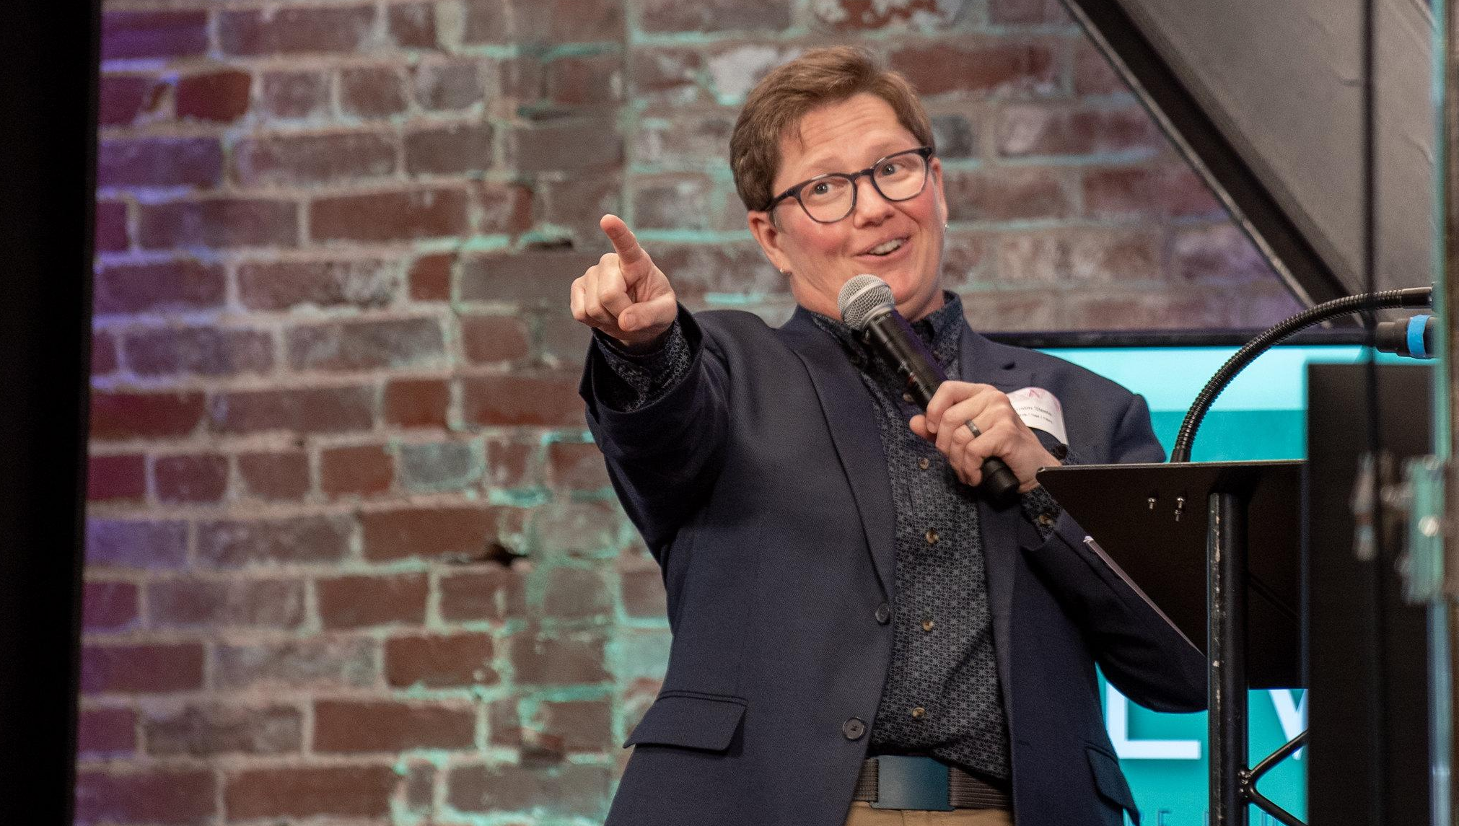
The Ask
Notes:
Design for your purpose

Slide 19
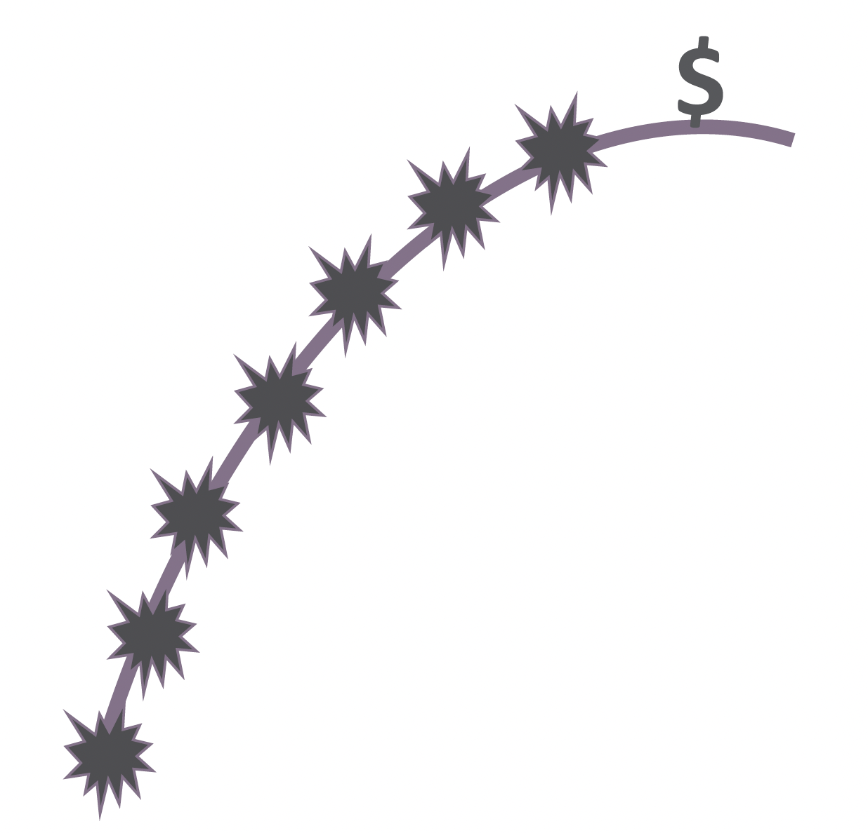

Slide 20
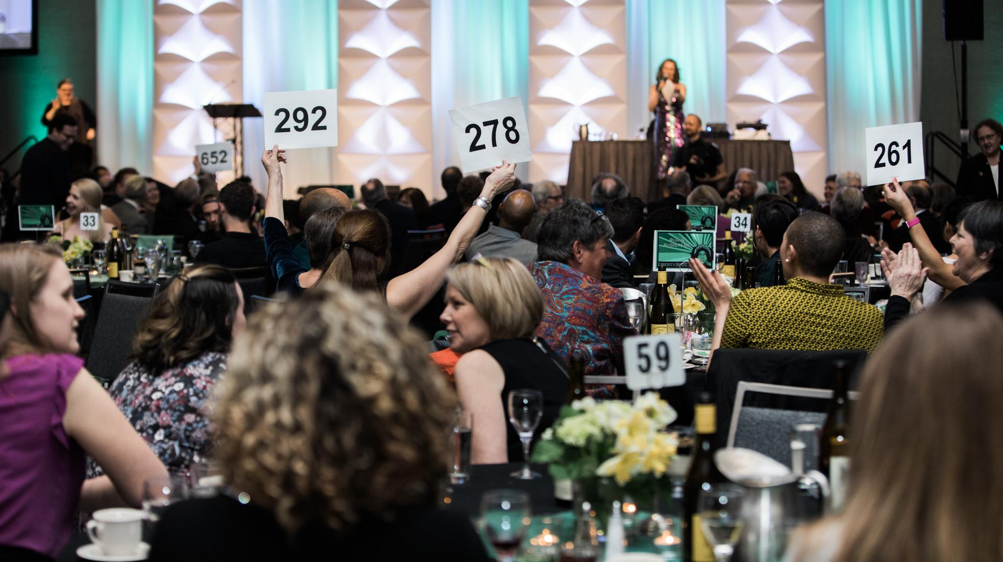
The Collection
Notes:
Design for your purpose

Slide 21

Active vs. Passive
Notes:
Design for your purpose

Slide 22
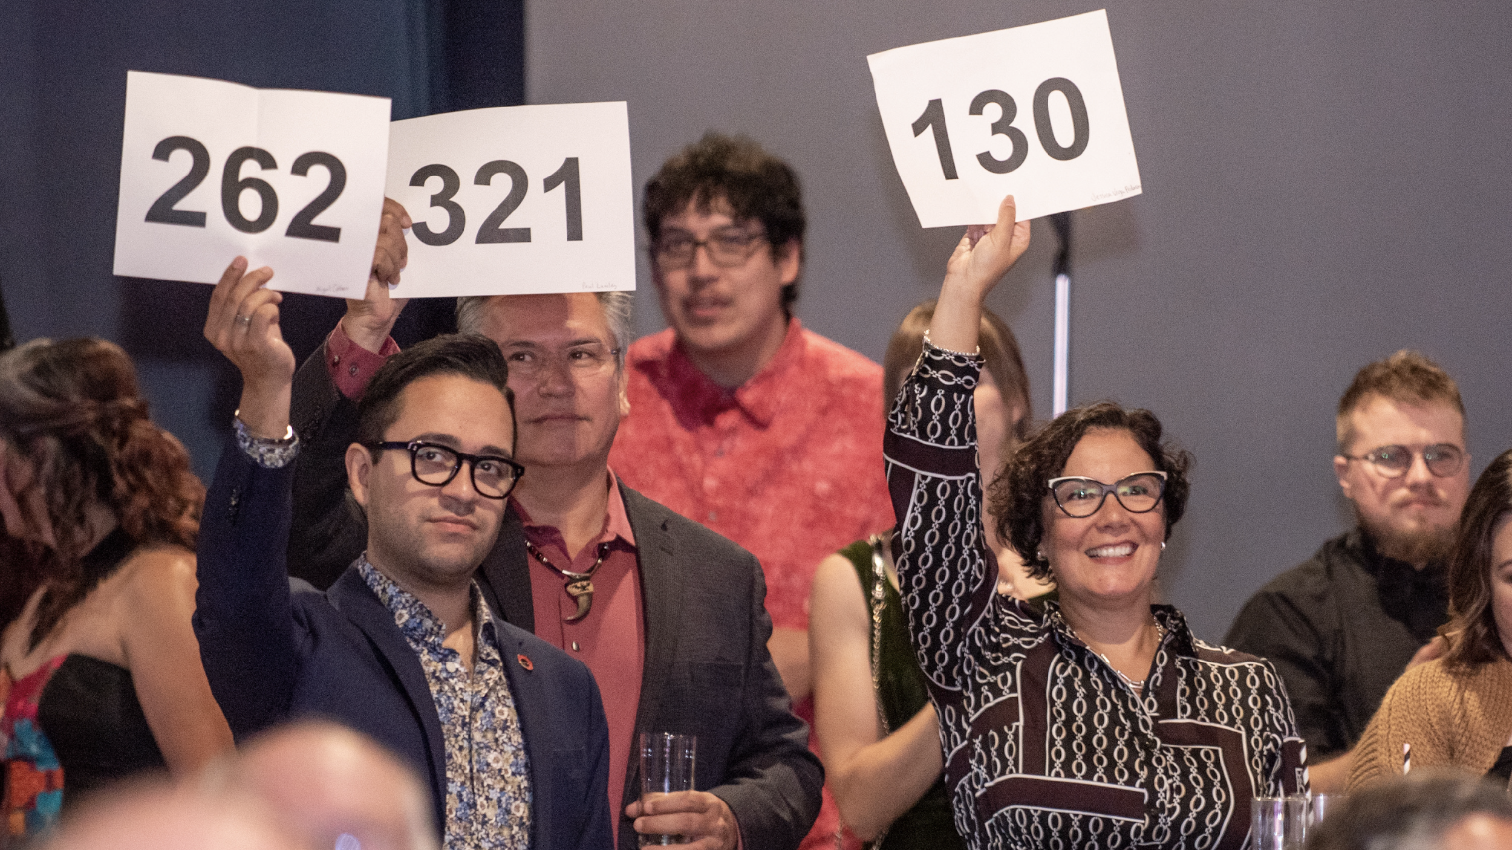
Pre-Commit Strategy
Notes:
Design for your purpose

Slide 23
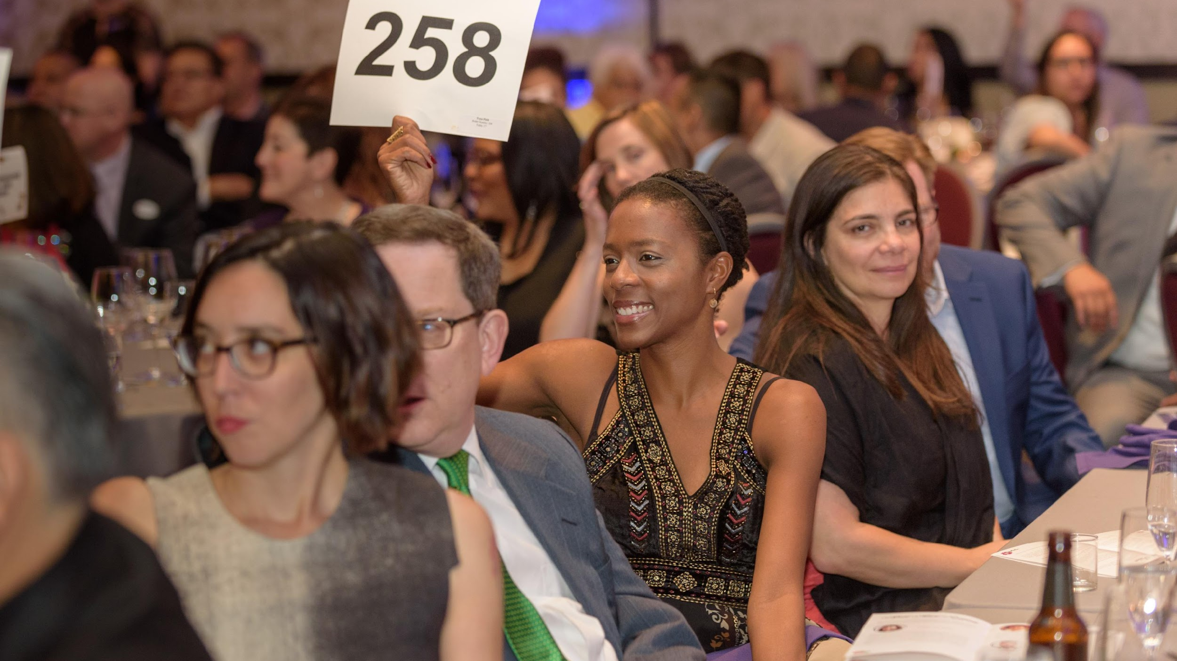
Starting Level
Notes:
Design for your purpose

Slide 24
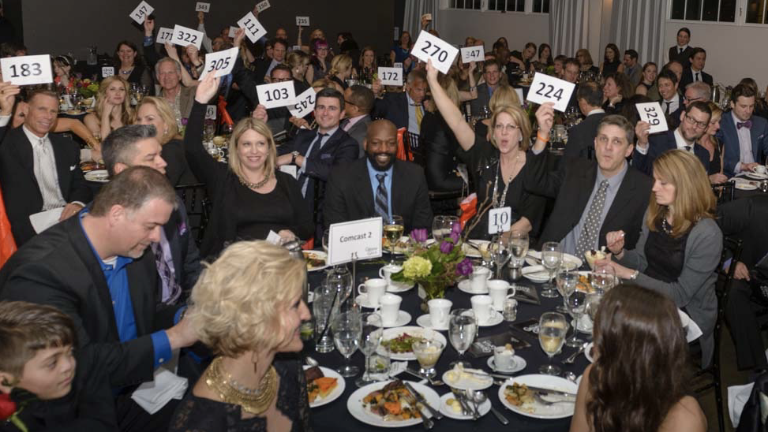
Matching Gift Challenge
Notes:
Design for your purpose

Slide 25
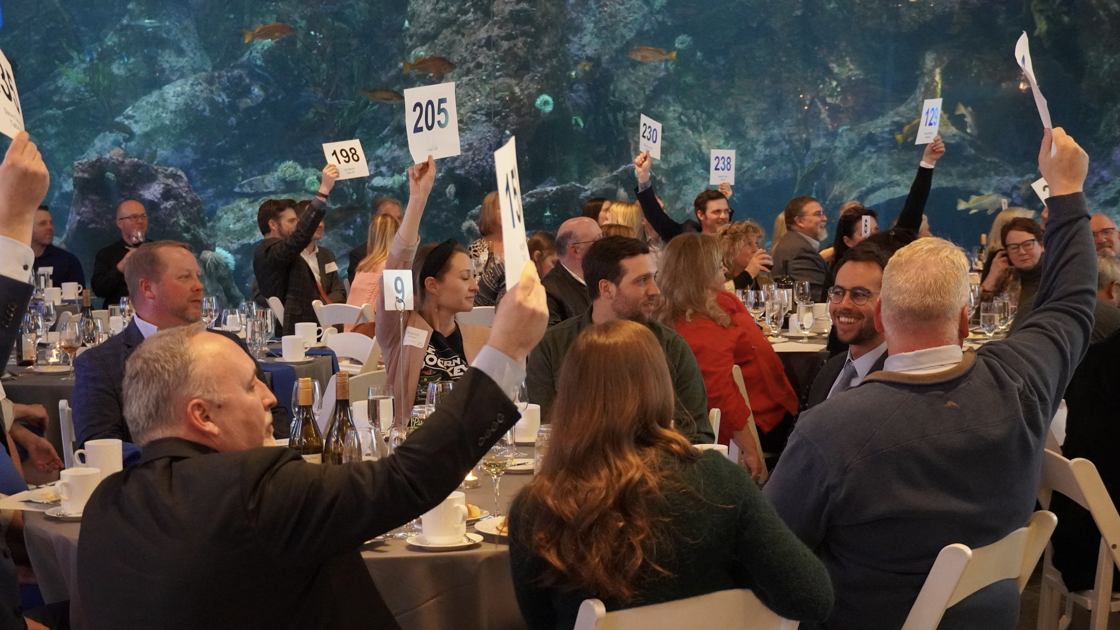
Corporate Match
Notes:
Design for your purpose

Slide 26
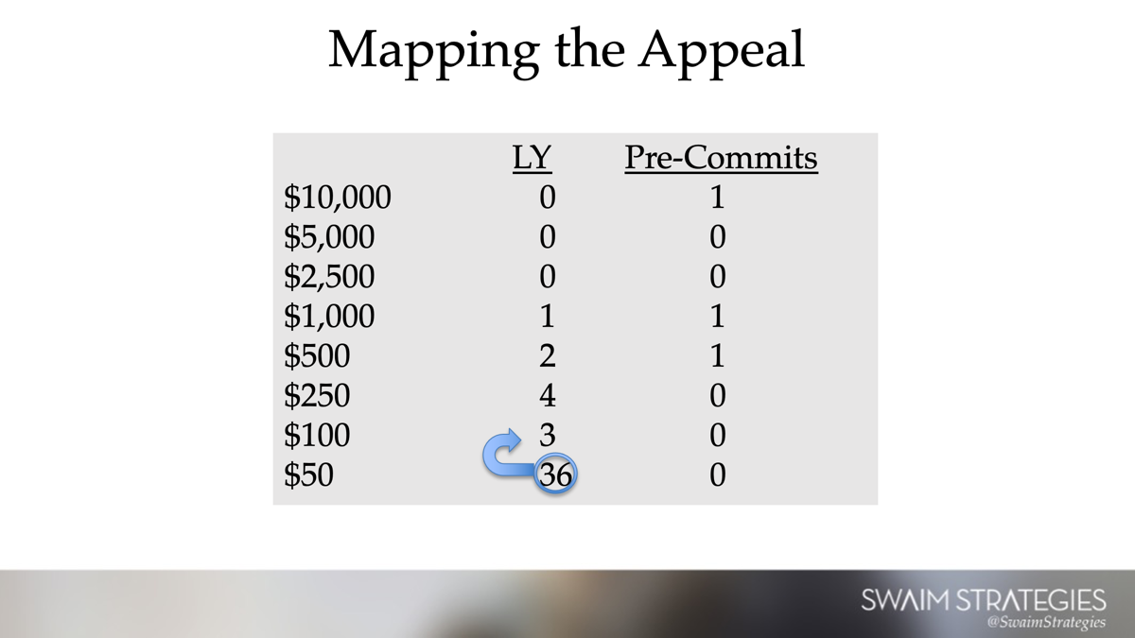
How to Create a Movement
Leader
  This sets your top giving level
  Easy to follow
First + second follower
  Three is a crowd
Movement must be public
  Active paddle raise
Momentum / tipping point
When more people join in it’s less risky
Be a part of the in crowd

Slide 27
